Slide 1

INTERNSHIP REVIEW -2
By: Rachana Sudhir
1by21is122

Slide 2

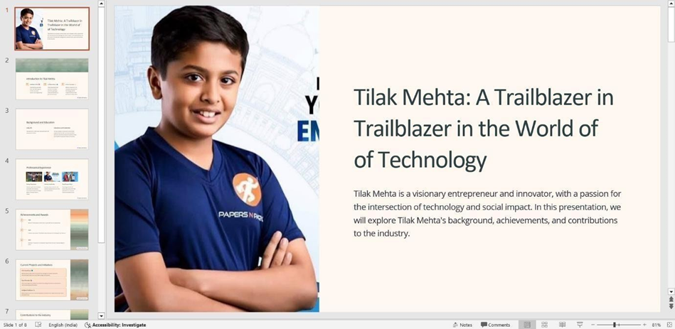
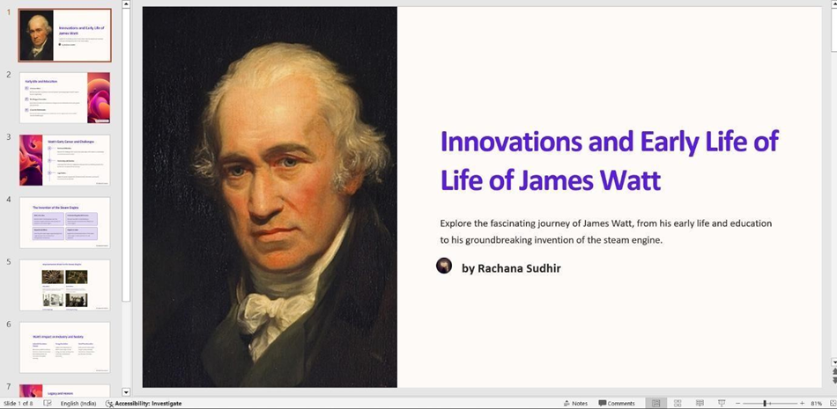
Activities conducted WITH TAKE-AWAYS
LIFE STORIES OF RENOWNED INNOVATORS SUCH AS TILAK MEHTA, JAMES WATT, AND ELI WHITNEY:
KEY TAKEWAYS:
- LEARN TO TAKE RISKS.
- LEARN TO MANAGE SETBACKS.

Slide 3

2. PICK AND SPEAK
KEY TAKEAWAYS:
-PURPOSE: DEVELOP CONFIDENCE AND PROFESSIONALISM IN SPEAKING.
-ACTIVITY: PARTICIPANTS ENGAGED IN IMPROMPTU SPEAKING ON VARIOUS TOPICS, FOSTERING PUBLIC SPEAKING SKILLS

Slide 4

3.Teamwork Emphasis KEY TAKEAWAYS: -Purpose: Highlight the importance of teamwork in entrepreneurship. -Activity: Interactive exercises emphasizing collaboration and effective team dynamics. Ex 1: we played the game called doctor-doctor this game requires 5-10 people, who will join hands and tangle themselves into human knots and calls out to the doctor, the doctor who is one of the team member has to untangle the knot.

Slide 5

Ex 1: we played the game called INSIDE-OUT this game requires 4-5 people, who will join hands above thir heads while facing each other, and they have to turn around without disconnecting their hands.

Slide 6
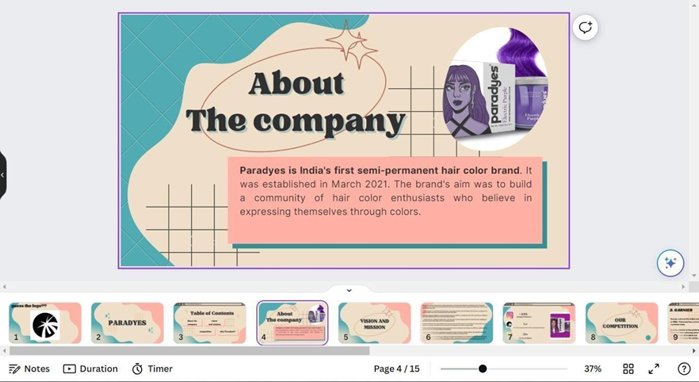
4.Startup Presentation KEY TAKEAWAYS: -Purpose: Apply research and presentation skills to analyze an existing startup. -Activity: Each participant selected a startup, researched its key aspects, and presented findings to the group.

Slide 7
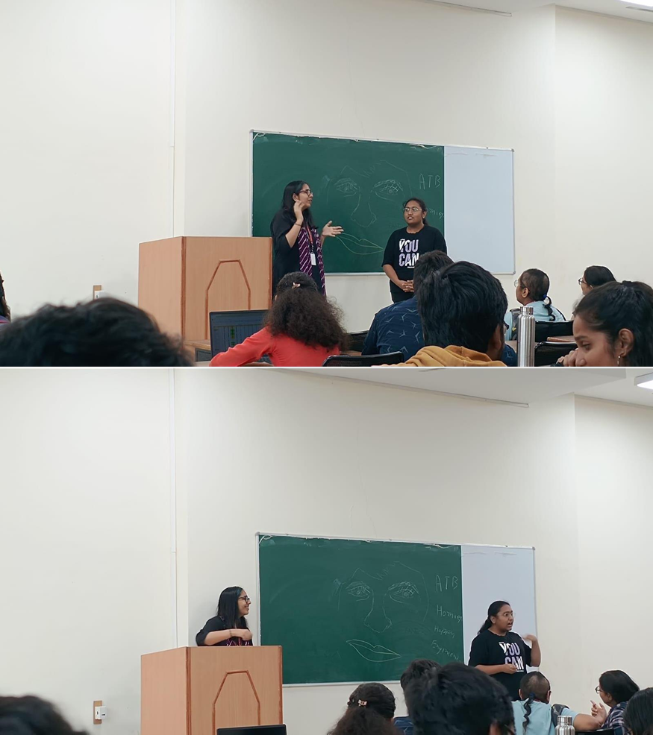
4. "Sell Me This Pen" Exercise key takeaways: -Purpose: Develop persuasive selling and marketing skills. -Activity: Participants were challenged to sell a pen, showcasing their ability to create compelling sales pitches.

Slide 8

5. Carnival Planning and Finance key takeaways: -Purpose: Acquire practical event planning and finance management skills. -Activity: Participants collaboratively planned a carnival, addressing logistical aspects and managing finances.

Slide 9

6. Innovative Startup Idea key takeawAys: -Purpose: Foster creativity and entrepreneurial thinking. -Activity: Participants generated an innovative startup idea and developed essential elements, including a logo, tagline, website, and a co-founder pitch email. The innovative startup idea generation activity fostered creativity through collaborative brainstorming. participants selected and refined ideas, creating tangible elements like logos and taglines. basic website concepts were explored, and persuasive communication skills were honed through crafting co-founder pitch emails. this brief but dynamic activity encapsulated crucial aspects of early-stage startup development.

Slide 10
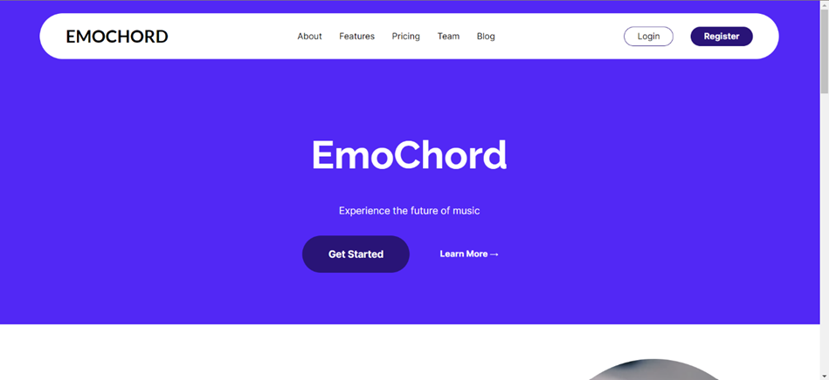
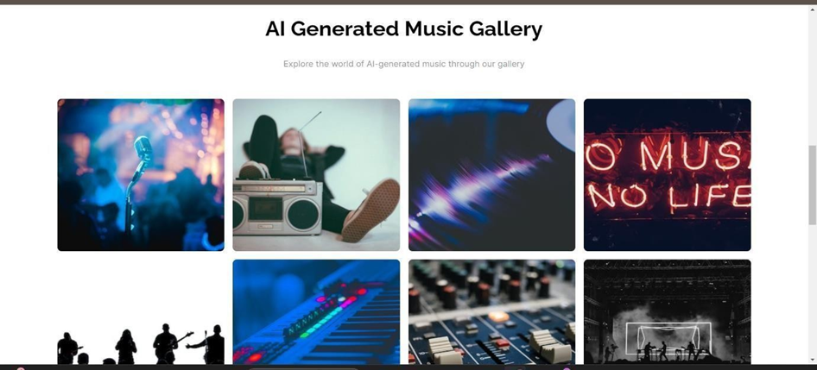
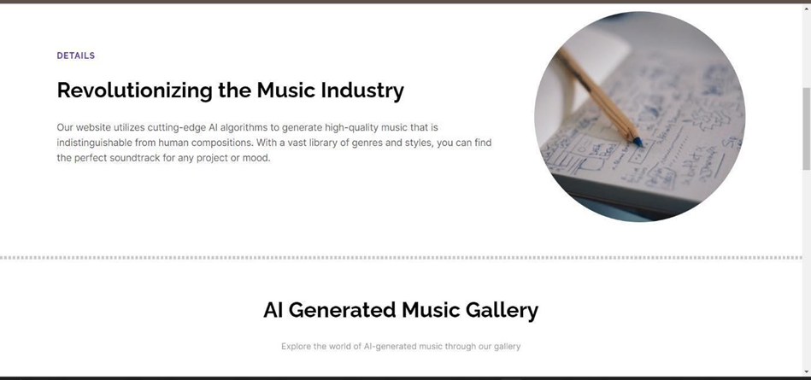
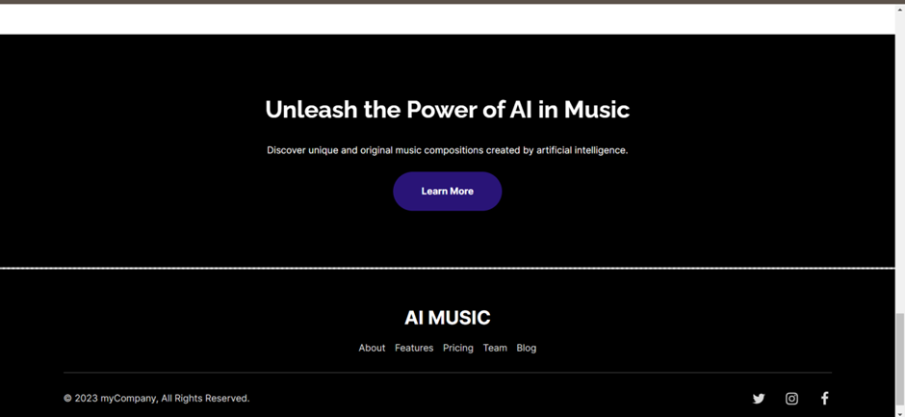

Slide 11
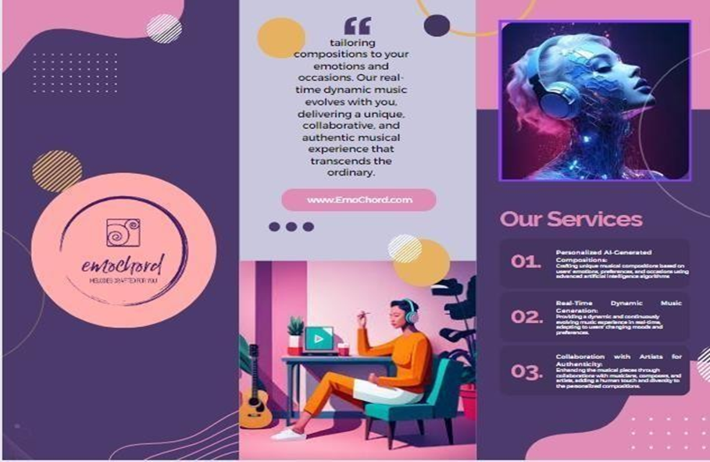


Slide 12
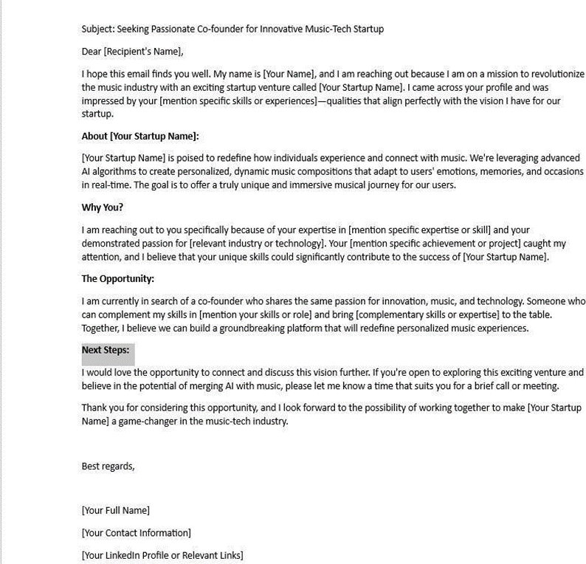

Slide 13
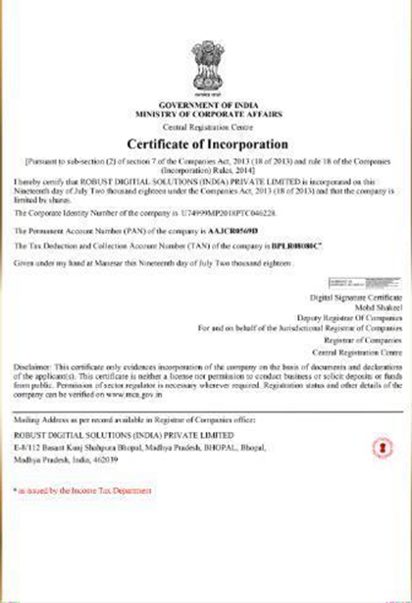
7. Company Registrations Education KEY TAKEAWAYS: -Purpose: Understand the legal aspects of entrepreneurship. - Activity: Instructional sessions on the procedures and importance of company registrations, providing insights into legal considerations

Slide 14

Thank You!

